Slide 1
Group No. 9
Names with Roll No.
Aman Kharwar: 40821014
Ansh Arora: 40821021
Bhavy Pandey: 40821030
Daksh Khurana: 40821035
Deepanshu: 40821039
Tushar Joshi: 40821116
Vishakha: 40821126

Slide 2

Problem and SDG GOAL
Our project aligns with the fourth Sustainable Development Goal of the United Nations, which focuses on providing equitable and high-quality education opportunities for all individuals, including vulnerable populations such as children in slums.
However, poverty and limited resources often prevent these children from accessing education, hindering their economic and personal growth.
Our initiative seeks to address these barriers by providing quality education to slum children, thereby promoting SDG 4 and improving their future prospects.

Slide 3
Describe your Planned Outcome
.
Increased cognitive skills: The project's educational component may lead to enhanced cognitive abilities in children, including memory, attention, and problem-solving.
Improved social skills: The project's educational component can assist children in acquiring social skills like communication, teamwork, and empathy, which may prove advantageous in both personal and professional aspects of their lives.
Increased confidence and self esteem: As the children acquire new knowledge and skills through education, they may experience a boost in self-esteem and confidence in their capabilities.
Enhanced quality of life: The project has the potential to enhance the quality of life for disadvantaged children by providing them with education and creating prospects for a brighter future.
Empowerment of local community: Through educating underprivileged children, the project can empower the local community and inspire them to take action towards enhancing the lives of disadvantaged individuals.

Slide 4
Implementation strategy
Site Preparation
Site Survey
Student Assessment
Strategy Development
Implementation

Slide 5
Project Implementation Tracker
Group 9 SEL PIT.xlsx

Slide 6
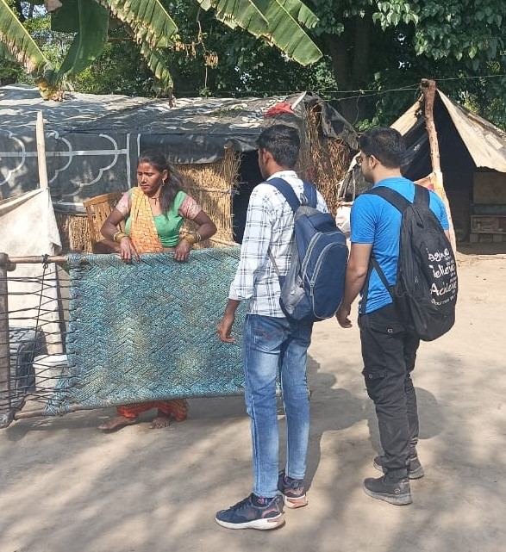
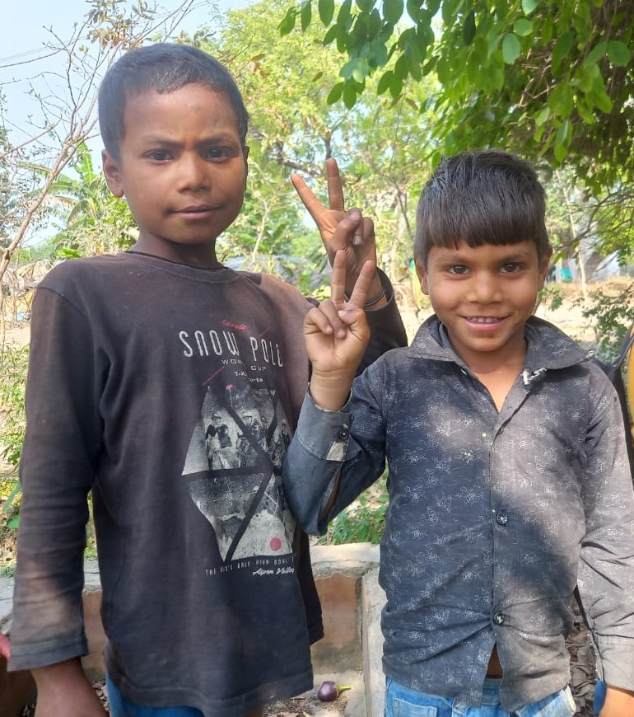
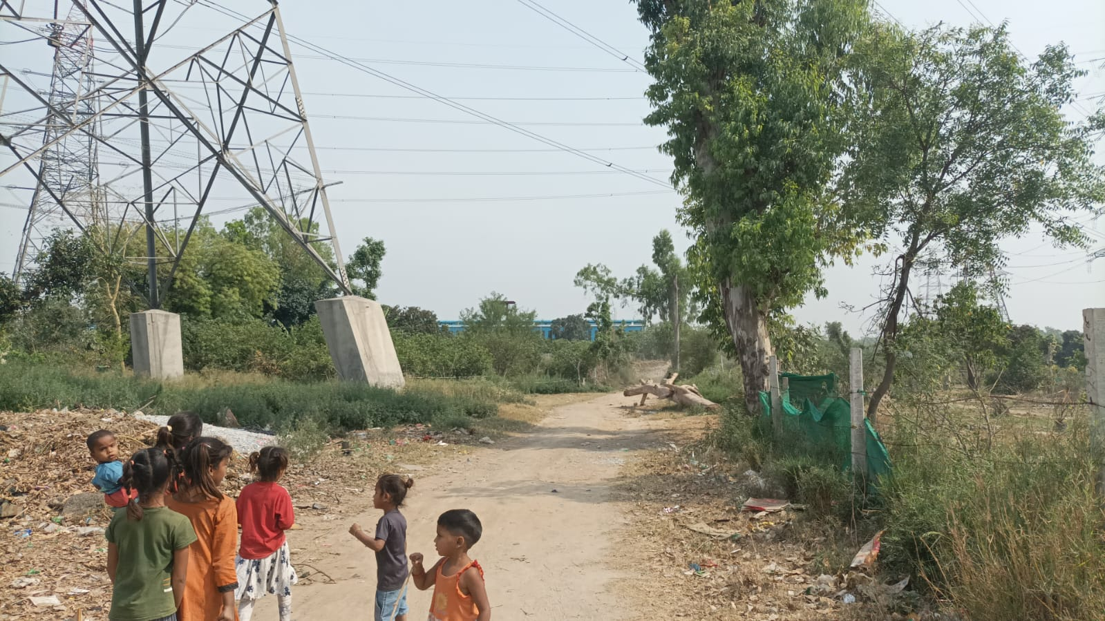
Challenges
Finding adequate location
Developing trust
Making them to listen
Bureaucracy
Increasing awareness
Changing mindset
Lack of basic resources

Slide 7
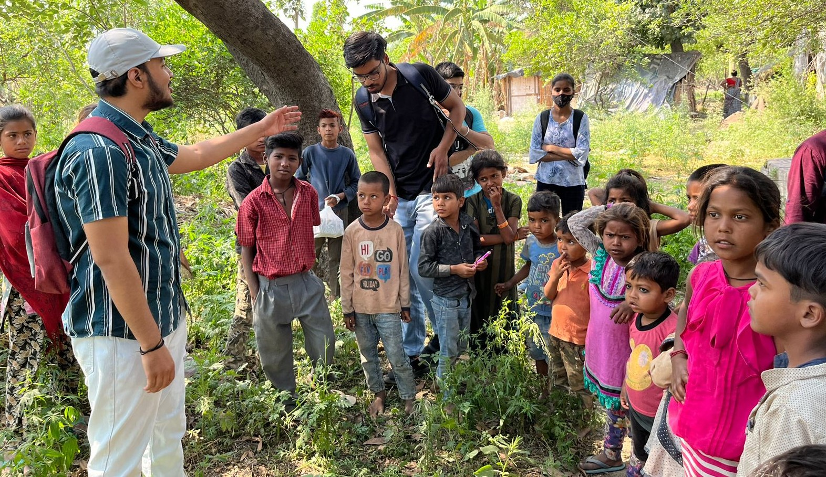
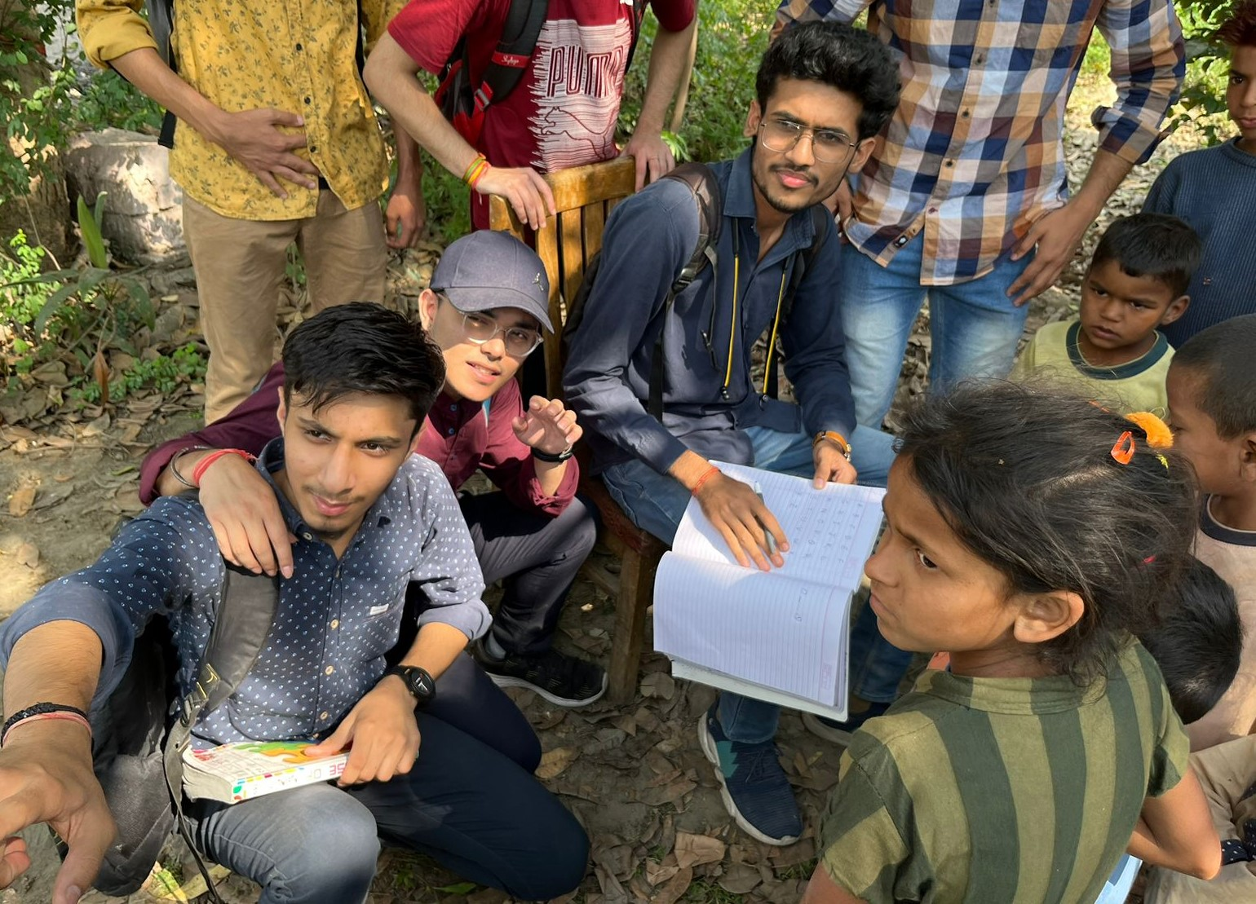
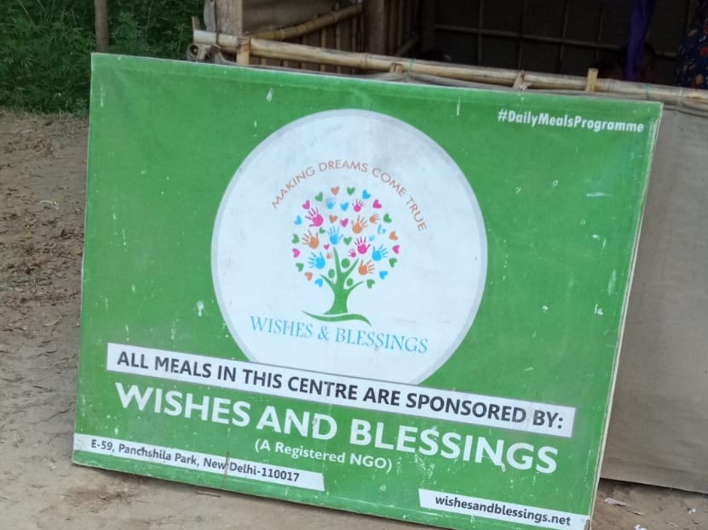
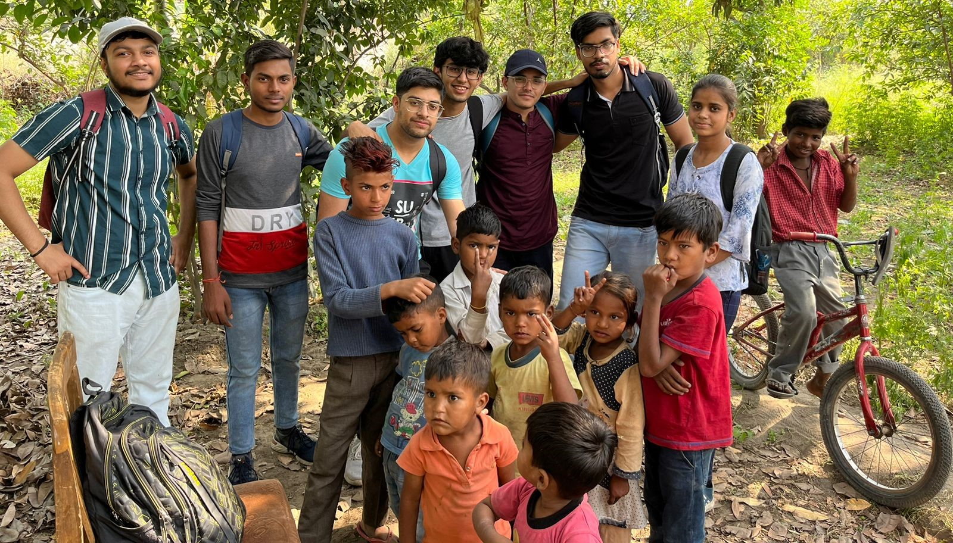
Actual Outcome
Improved Social Skills: The educational program proved beneficial for underprivileged children as it provided them with essential social skills like communication, teamwork, and problem-solving abilities, which can assist them in their future interactions with others and in both their personal and professional lives.
Increased Motivation: The act of rewarding students based on their performance would have served as a motivational factor for them to enhance their learning and performance. This positive reinforcement would have encouraged them to take charge of their education and continue to learn beyond the duration of the program.
Improved Self-Esteem: By providing recognition and rewards to the students, their self-esteem and confidence levels would have increased, which are crucial elements in achieving success in life. This positive impact would have extended to their overall well-being and quality of life.
.
..

Slide 8
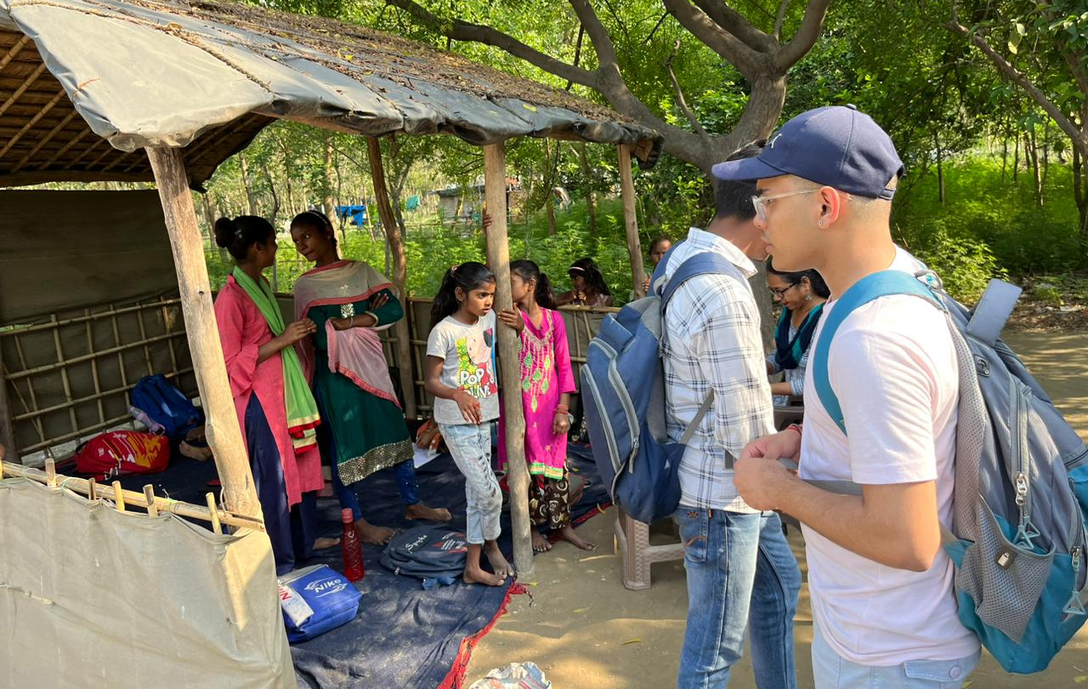
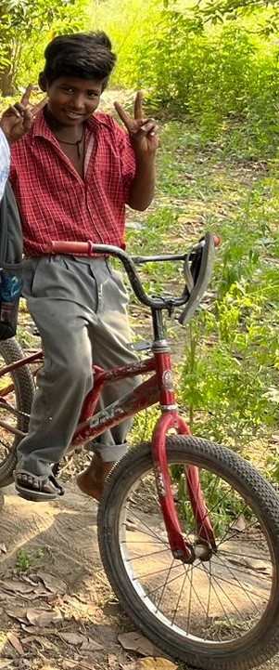
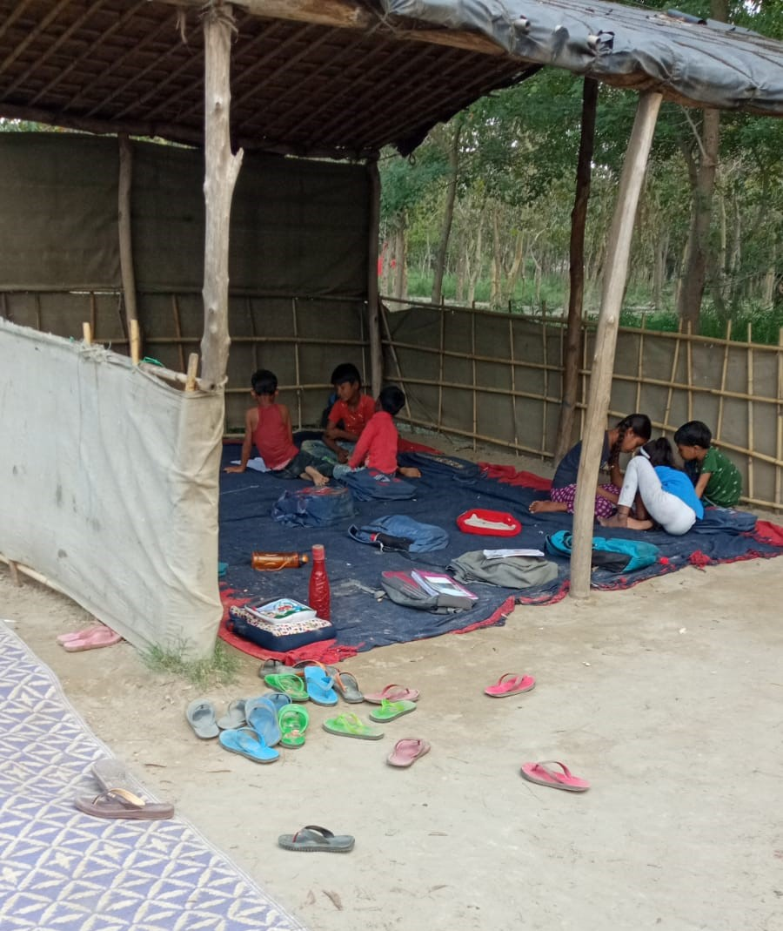
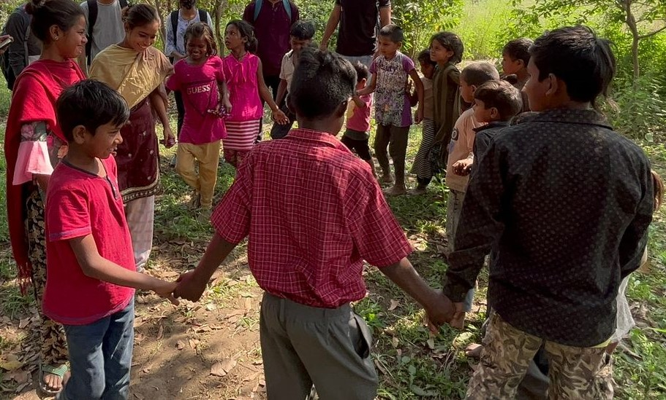
AREAS OF Learning and Reflection
.
Language barriers
Limited access to technology
Health issues
Economic barriers
Family responsibilities
Social stigma

Slide 9
THANK YOU

